Slide 1

GUI PROGRAMMING

Slide 2
Introduction
Python offers multiple options for developing GUI (Graphical User Interface). Out of all the GUI methods, tkinter is the most commonly used method.

Slide 3
Introduction
To create a tkinter app:
Importing the module – tkinter
Create the main window (container)
Add any number of widgets to the main window
Apply the event Trigger on the widgets.

Slide 4
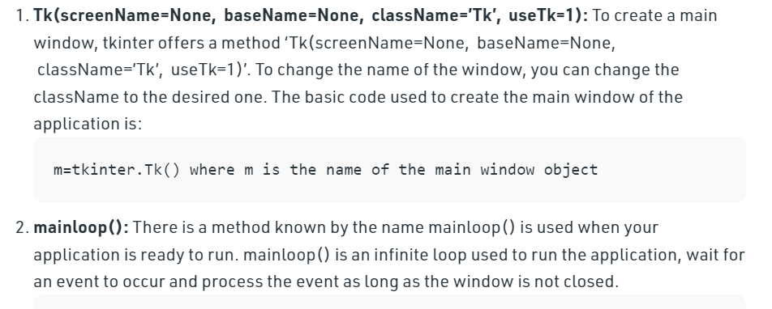
Introduction
Importing tkinter is same as importing any other module in the Python code.

Slide 5
There are mainly three geometry manager classes class.
pack() method:It organizes the widgets in blocks before placing in the parent widget.
grid() method:It organizes the widgets in grid (table-like structure) before placing in the parent widget.
place() method:It organizes the widgets by placing them on specific positions directed by the programmer.

Slide 6
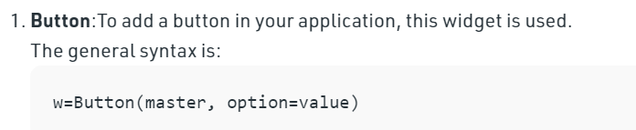
Some of the major widgets are explained below:

Slide 7
widgets
activebackground: to set the background color when button is under the cursor.
activeforeground: to set the foreground color when button is under the cursor.
bg: to set he normal background color.
command: to call a function.
font: to set the font on the button label.
image: to set the image on the button.
width: to set the width of the button.
height: to set the height of the button.

Slide 8
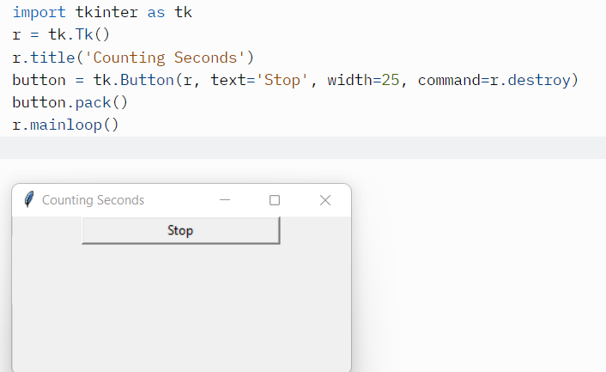
Using Button

Slide 9
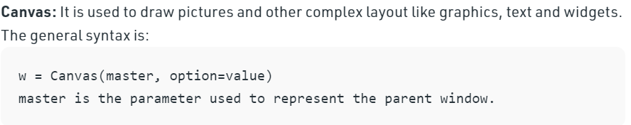
widgets

Slide 10
There are number of options which are used to change the format of the widget. Number of options can be passed as parameters separated by commas. Some of them are listed below.
bd: to set the border width in pixels.
bg: to set the normal background color.
cursor: to set the cursor used in the canvas.
highlightcolor: to set the color shown in the focus highlight.
width: to set the width of the widget.
height: to set the height of the widget.

Slide 11
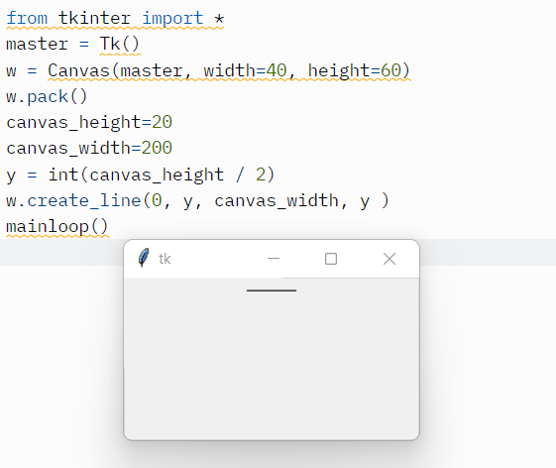
Line widget

Slide 12
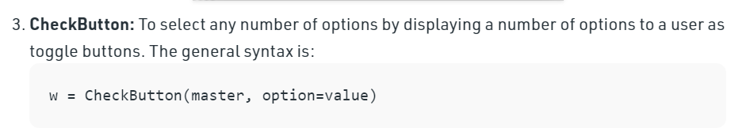
Checkbox

Slide 13
There are number of options which are used to change the format of this widget. Number of options can be passed as parameters separated by commas. Some of them are listed below.
Title: To set the title of the widget.
activebackground: to set the background color when widget is under the cursor.
activeforeground: to set the foreground color when widget is under the cursor.
bg: to set he normal backgrouSteganographyBreak
Secret Code:
Attach a File:nd color.
command: to call a function.
font: to set the font on the button label.
image: to set the image on the widget.

Slide 14
Code:
from tkinter import *
master = Tk()
var1 = IntVar()
Checkbutton(master, text='male', variable=var1).grid(row=0, sticky=W)
var2 = IntVar()
Checkbutton(master, text='female', variable=var2).grid(row=1, sticky=W)
mainloop()

Slide 15
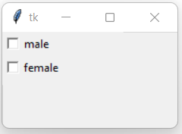
output

Slide 16
Code:
from tkinter import *
master = Tk()
Label(master, text='First Name').grid(row=0)
Label(master, text='Last Name').grid(row=1)
e1 = Entry(master)
e2 = Entry(master)
e1.grid(row=0, column=1)
e2.grid(row=1, column=1)
mainloop()

Slide 17
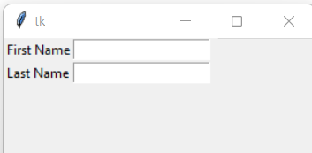
output

Slide 18
code
from tkinter import *
root = Tk()
frame = Frame(root)
frame.pack()
bottomframe = Frame(root)
bottomframe.pack( side = BOTTOM )
redbutton = Button(frame, text = 'Red', fg ='red')
redbutton.pack( side = LEFT)
greenbutton = Button(frame, text = 'Brown', fg='brown')
greenbutton.pack( side = LEFT )
bluebutton = Button(frame, text ='Blue', fg ='blue')
bluebutton.pack( side = LEFT )
blackbutton = Button(bottomframe, text ='Black', fg ='black')
blackbutton.pack( side = BOTTOM)
root.mainloop()

Slide 19
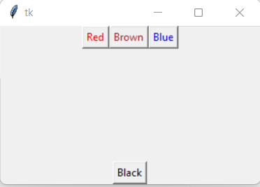
output

Slide 20
listbox
from tkinter import *
top = Tk()
Lb = Listbox(top)
Lb.insert(1, 'Python')
Lb.insert(2, 'Java')
Lb.insert(3, 'C++')
Lb.insert(4, 'Any other')
Lb.pack()
top.mainloop()

Slide 21
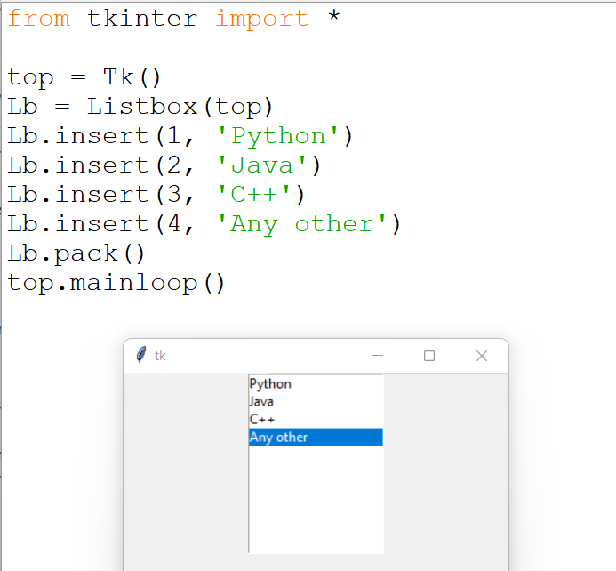

Slide 22
Code - Menu
from tkinter import *
root = Tk()
menu = Menu(root)
root.config(menu=menu)
filemenu = Menu(menu)
menu.add_cascade(label='File', menu=filemenu)
filemenu.add_command(label='New')
filemenu.add_command(label='Open...')
filemenu.add_separator()
filemenu.add_command(label='Exit', command=root.quit)
helpmenu = Menu(menu)
menu.add_cascade(label='Help', menu=helpmenu)
helpmenu.add_command(label='About')
mainloop()

Slide 23
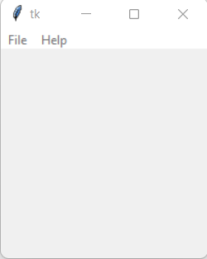
Output

Slide 24
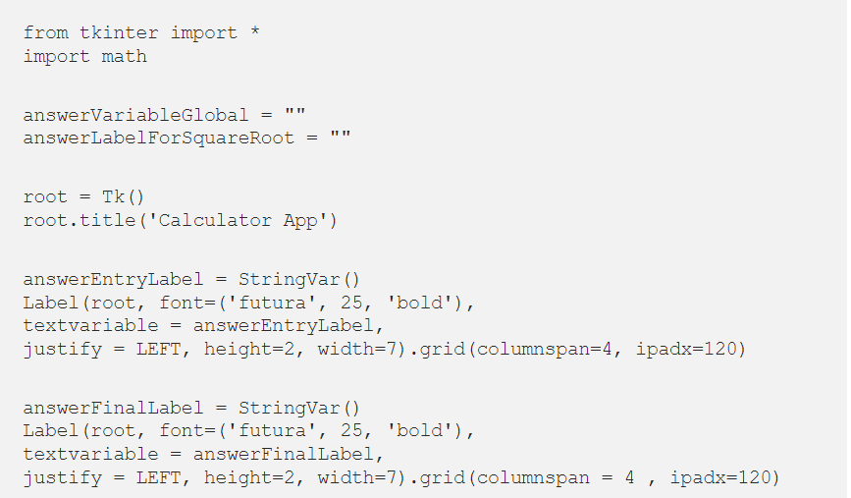
Calculator

Slide 25
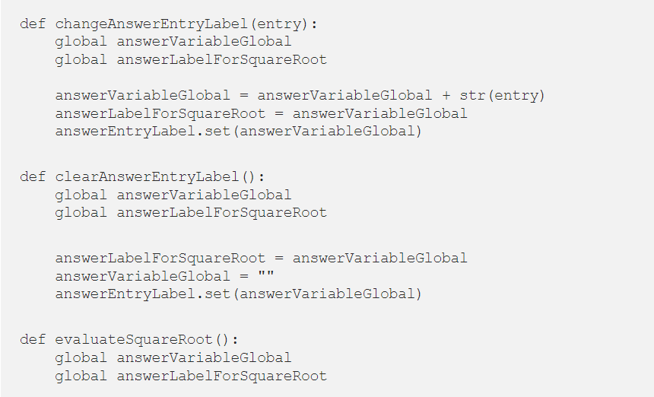

Slide 26
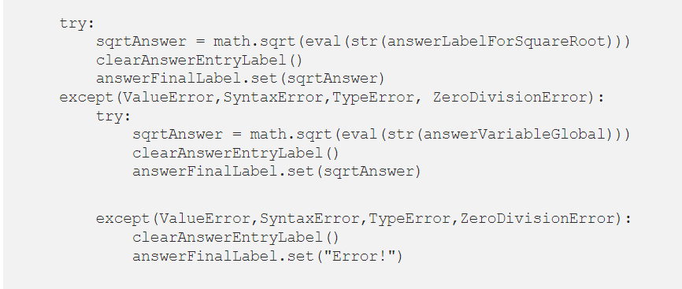

Slide 27
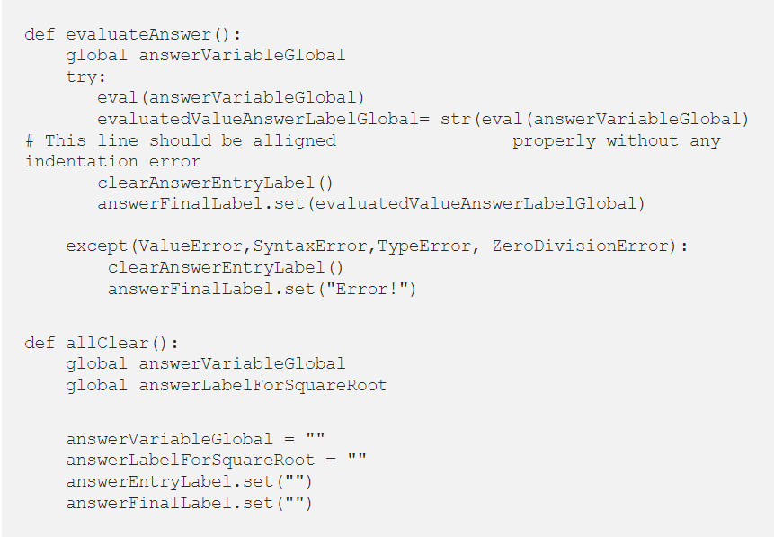

Slide 28
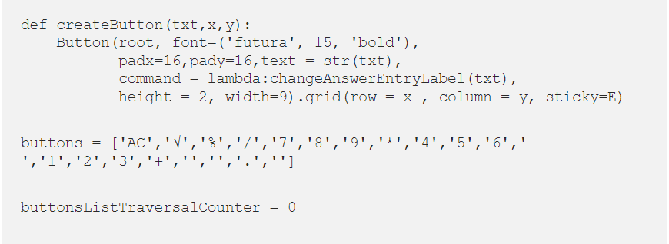

Slide 29
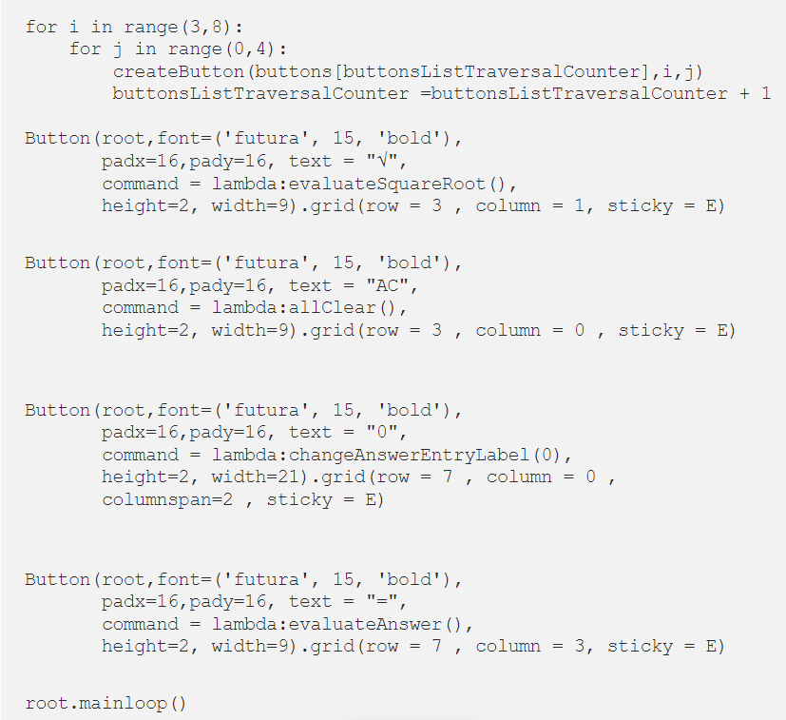

Slide 30
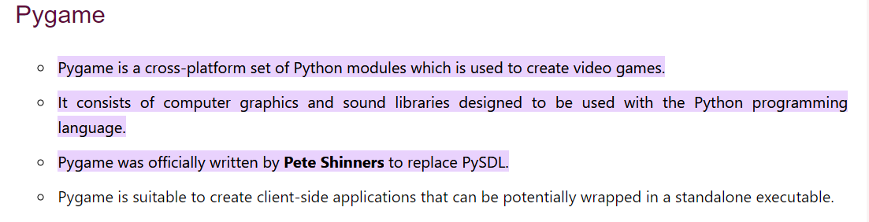
Pygame

Slide 31
Ways to install pygame
There are mainly two ways to install Pygame
1. Installing through pip: The good way to install Pygame is with the pip tool (which is what python uses to install packages). The command is the following:
py -m pip install -U pygame --user

Slide 32
Ways to Install
2. Installing through an IDE: The second way is to install it through an IDE and here we are using Pycharm IDE. Installation of pygame in the pycharm is straightforward. We can install it by running the above command in the terminal or use the following steps:

Slide 33
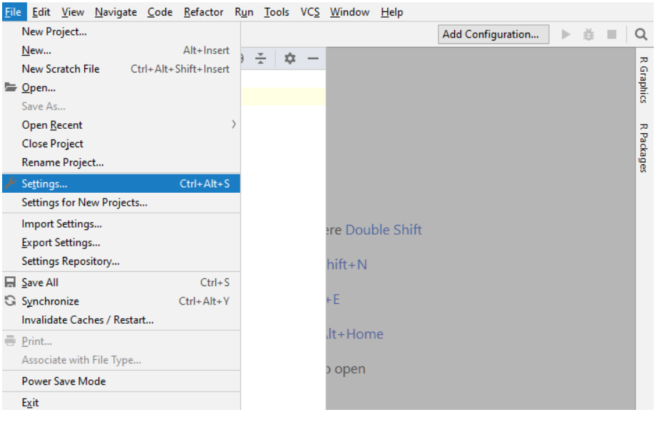
Open the File tab and click on the Settings option.

Slide 34
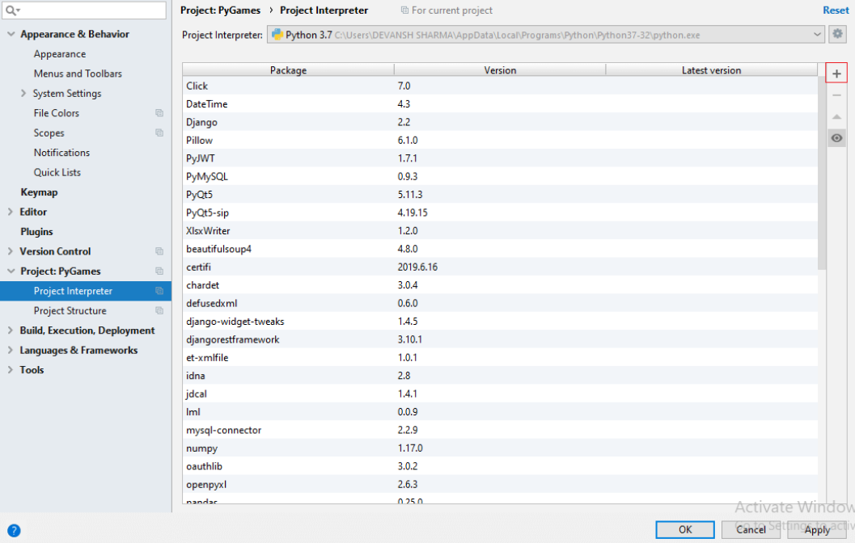
Select the Project Interpreter and click on the + icon.

Slide 35
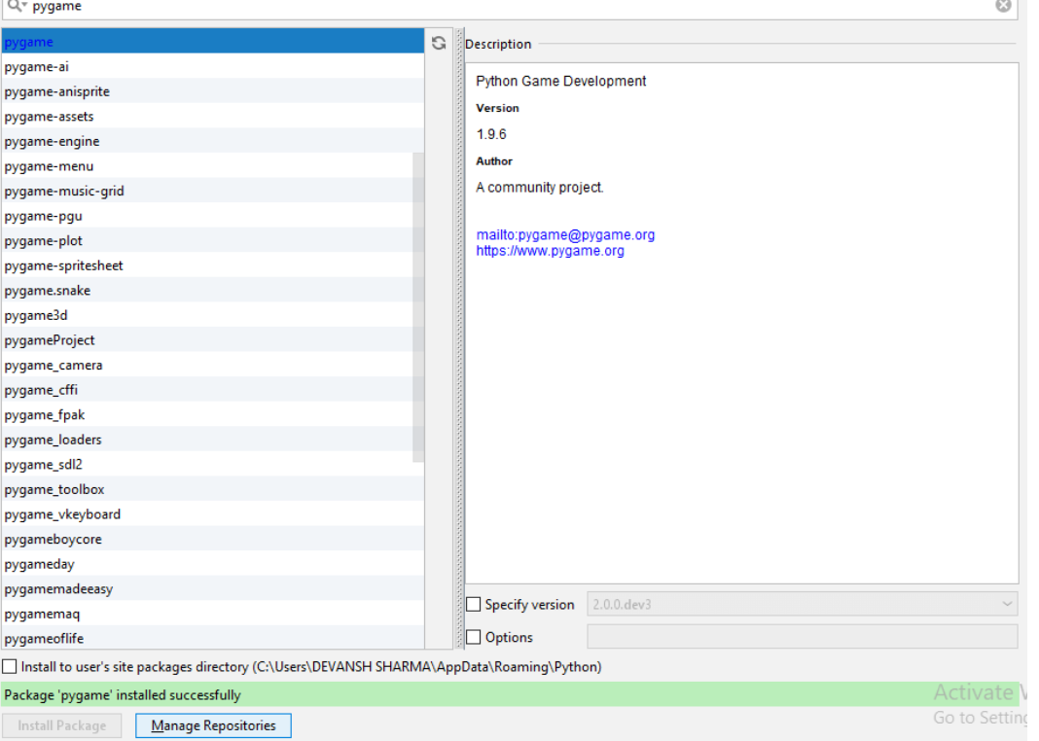
It will display the search box. Search the pygame and click on the install package button.

Slide 36
If the command runs successfully without throwing any errors, it means we have successfully installed Pygame and found the correct version of IDLE to use for pygame programming.

Slide 37
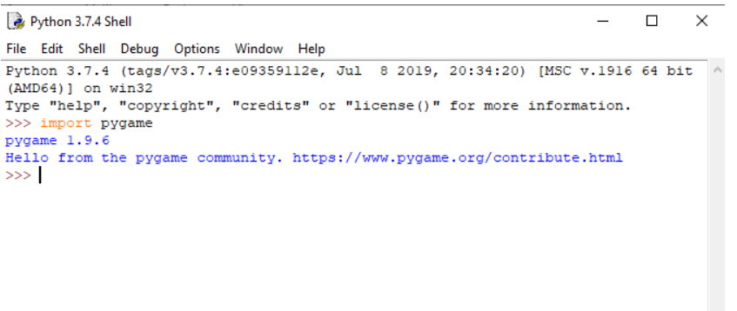

Slide 38
Program
import pygame
pygame.init()
screen = pygame.display.set_mode((640, 480))
done = False
#load the fonts
font = pygame.font.SysFont("Times new Roman", 72)
# Render the text in new surface
text = font.render("Hello, Pygame", True, (158, 16, 16))

Slide 39
while not done:
for event in pygame.event.get():
if event.type == pygame.QUIT:
done = True
if event.type == pygame.KEYDOWN and event.key == pygame.K_ESCAPE:
done = True
screen.fill((255, 255, 255))
#We will discuss blit() in the next topic
screen.blit(text,(320 - text.get_width() // 2, 240 - text.get_height() // 2))
pygame.display.flip()

Slide 40
